Slide 1

Safest Solutions Green Group

Slide 2
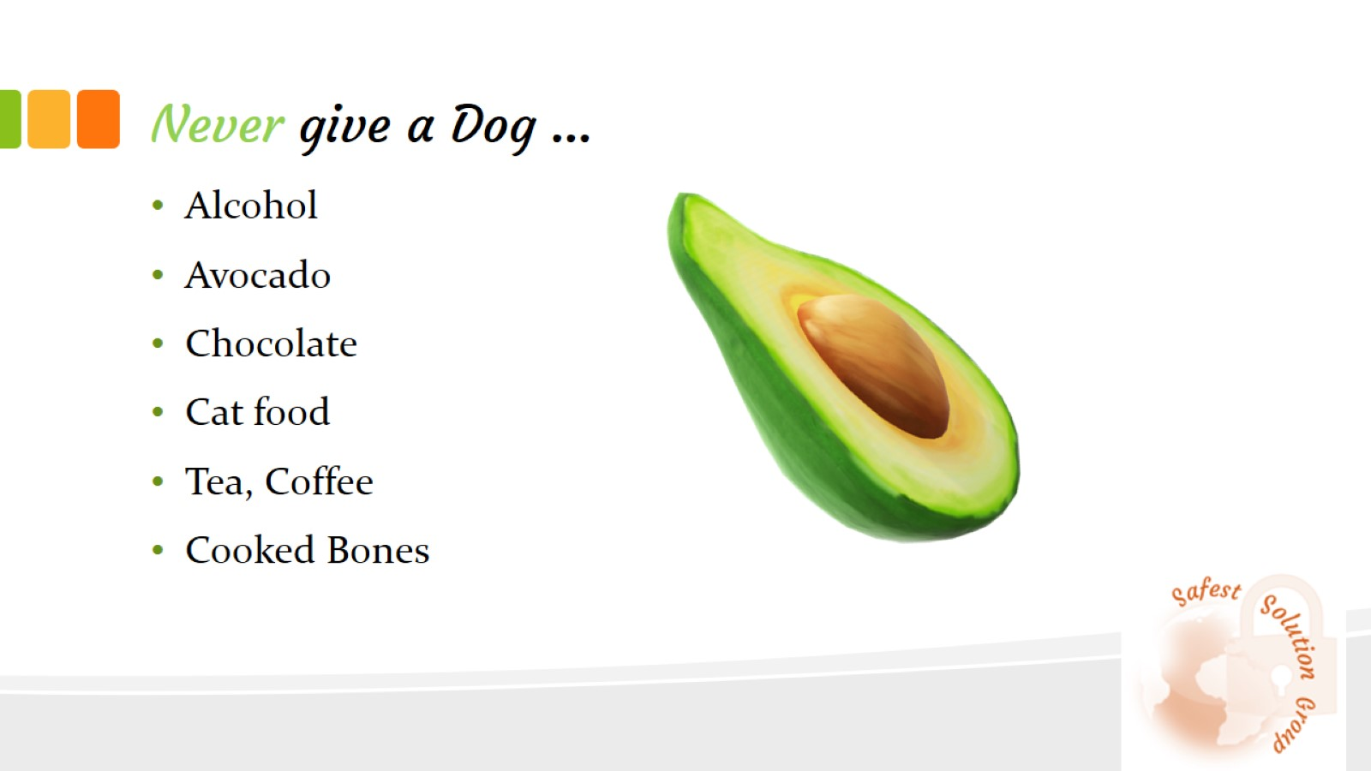
Never give a Dog …

Slide 3

Appropriate for Dogs …

Slide 4
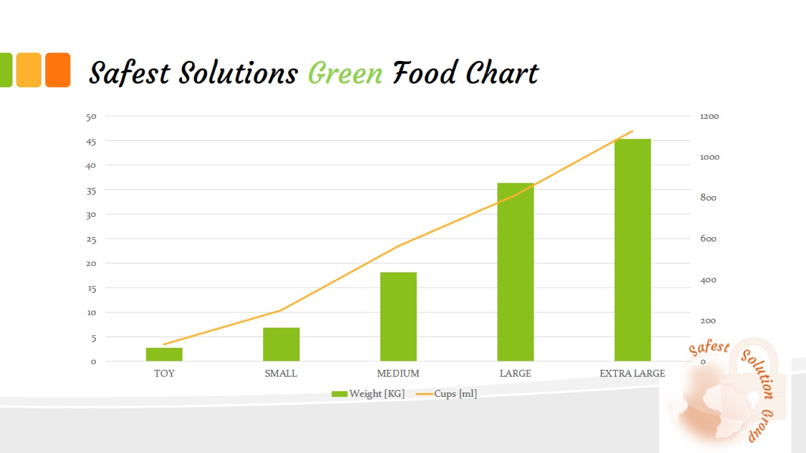
Safest Solutions Green Food Chart

Slide 5
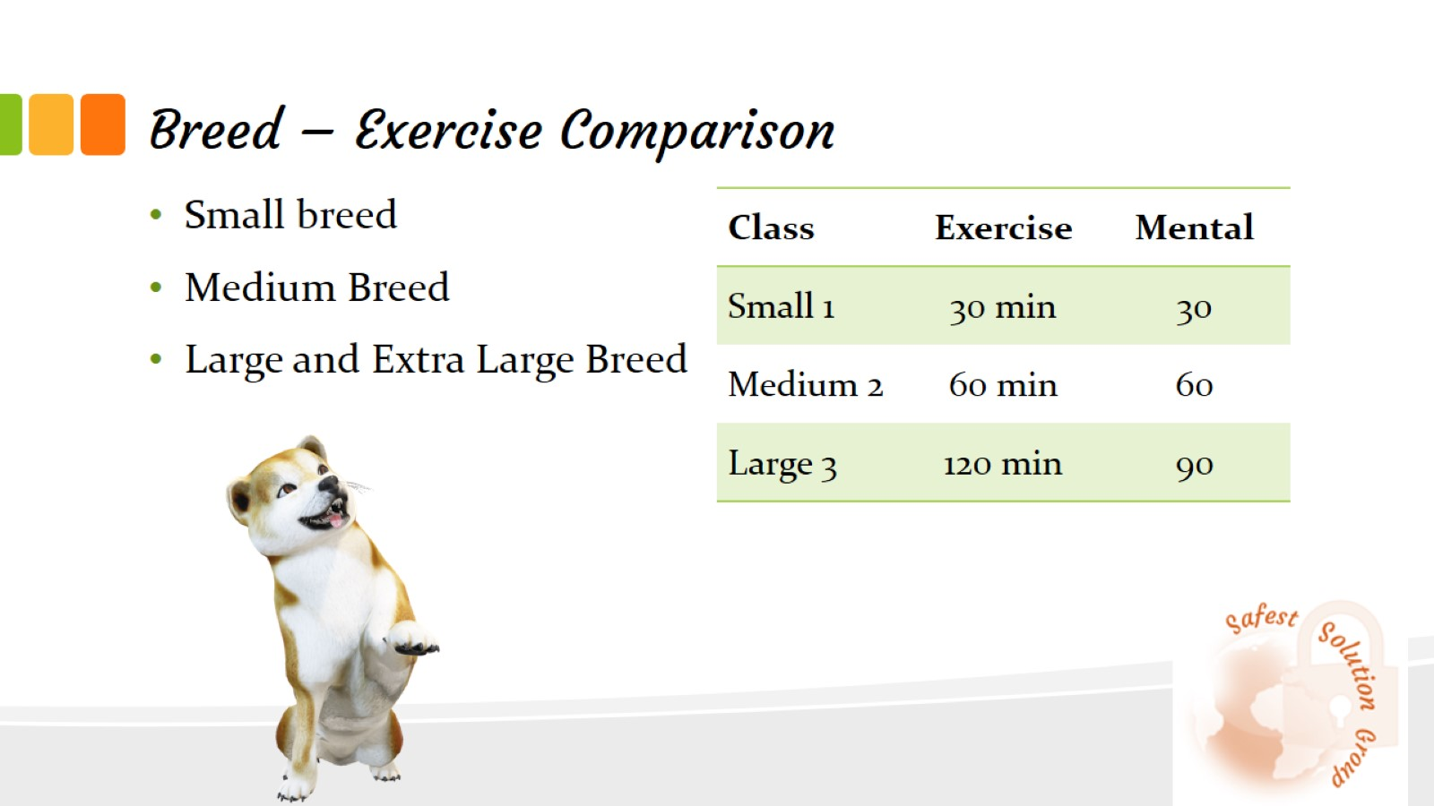
Breed – Exercise Comparison

Slide 6
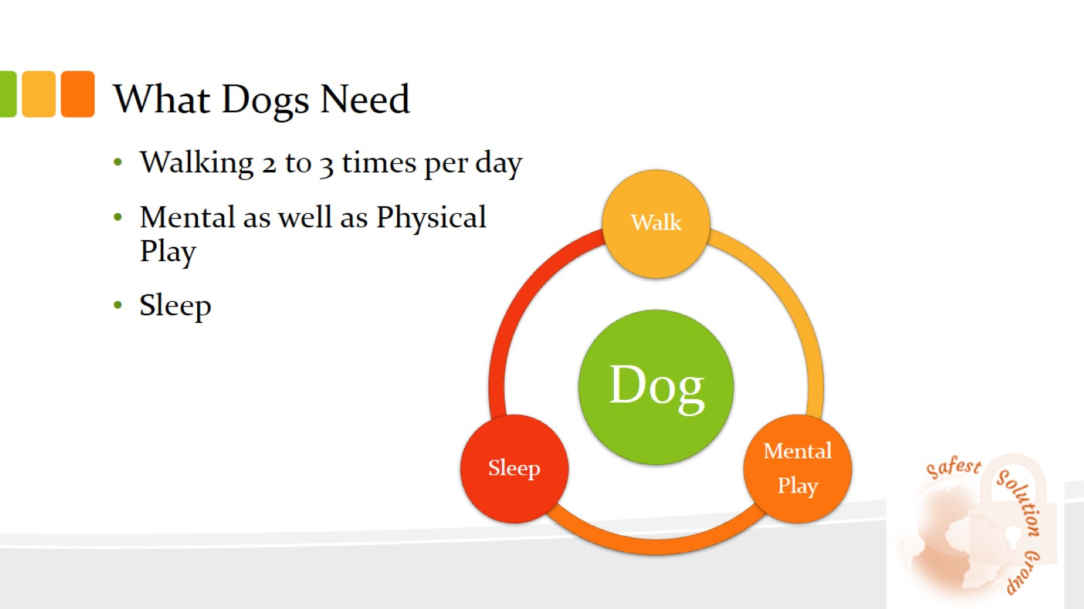
What Dogs Need

